Slide 1
Introduction to XMPP
Joe Hildebrand

Slide 2
What is XMPP?
eXtensible Messaging and Presence Protocol
Bi-directional streaming XML
Core: IETF RFC 6120, 7590, 6121
Extensions: XMPP Standards Foundation (XSF)
Membership-based
Elected technical council
Unit of work: XMPP Extension Protocol (XEP)
Process: Experimental, Proposed, Draft, Final
Goals:
Simple clients
Federate everything

Slide 3
Related RFCs
RFC | Name | Description
RFC 6120 | XMPP Core | XMPP core features Updated by 7590 (TLS)
RFC 6121 | XMPP IM | XMPP Instant Messaging and Presence
RFC 3922 | XMPP CPIM | Mapping XMPP to Common Presence and Instant Messaging (CPIM)
RFC 3923 | XMPP E2E | End-to-End Signing and Object Encryption for XMPP
RFC 5122 | XMPP URI | Internationalized Resource Identifiers (IRIs) and Uniform Resource Identifiers (URIs) for XMPP
RFC 4854 | XMPP URN | Uniform Resource Name (URN) Namespace for XMPP

Slide 4
What is XMPP ?
The eXtensible Messaging and Presence Protocol (XMPP) is a TCP communications protocol based on XML that enables near-real-time exchange of structured data between two or more connected entities.
Out-of-the-box features of XMPP include presence information and contact list maintenance.
Due in part to its open nature and XML foundation, XMPP has been extended for use in publish-subscribe systems
Perfect for IoT applications.
https://www.infoworld.com/article/2972143/internet-of-things/real-time-protocols-for-iot-apps.html

Slide 5
XMPP Architecture
Client
Client
Server1
Server2
Client
Client
Client
Client
Server3
Client
Client
Client
Server<->Server: Port 5269
Client<->Server: Port 5222

Slide 6
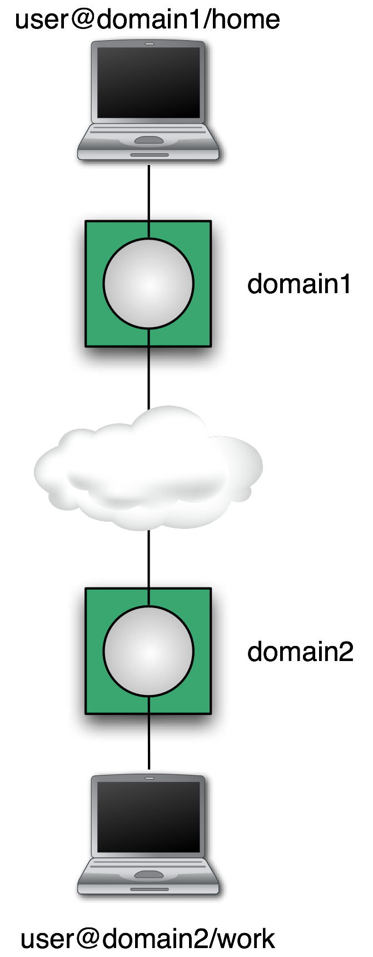
XMPP Architecture
Addressing Scheme: node@domain/resource
JID = Jabber ID
Node: identity, e.g. user name
Domain: DNS domain name
Resource: device identifier
node@domain identifies a person
Client talks to “local” server
Wherever the user account is hosted
Tied to directory if desired
Organizational policy enforced
Servers talk to other servers
DNS lookup on domain portion of address
Dialback, MTLS for security
One connection for many conversations
Notes:
The basic idea behind Server Dialback is that a receiving server does not accept XMPP traffic from a sending server until it has (a) "called back" the authoritative server for the domain asserted by the sending server and (b) verified that the sending server is truly authorized to generate XMPP traffic for that domain.
Multiplexed Transport Layer Security (MTLS) protocol is a new TLS sub-protocol running over TLS or DTLS. The MTLS design provides application multiplexing over a single TLS (or DTLS) session. Therefore, instead of associating a TLS connection with each application, MTLS allows several applications to protect their exchanges over a single TLS session.

Slide 7
XML Refresher
Element
Attribute
Namespace
Language
Text
Attribute
<geoloc xmlns='http://jabber.org/protocol/geoloc' xml:lang='en' id='14'> <lat>38.9</lat> <lon>-77.1</lon> <locality>Arlington</locality> <region>VA</region> </geoloc>
Element

Slide 8
XMPP Streams
Client connects TCP socket to server
Client sends stream start tag: <stream:stream xmlns='jabber:client' xmlns:stream='http://etherx.jabber.org/streams' to='example.com' version='1.0'>
Server sends stream start tag back: <stream:stream xmlns='jabber:client' xmlns:stream='http://etherx.jabber.org/streams' from='example.com’ id='someid' version='1.0'>
Each child element of stream: a “stanza”

Slide 9
Stream features
After stream start, server sends feature list: <stream:features> <starttls xmlns='urn:ietf:params:xml:ns:xmpp-tls'/> <mechanisms xmlns='urn:ietf:params:xml:ns:xmpp-sasl'> <mechanism>DIGEST-MD5</mechanism> </mechanisms> <compression xmlns='http://jabber.org/features/compress'> <method>zlib</method> </compression> </stream:features>
Client can negotiate any of these features

Slide 10
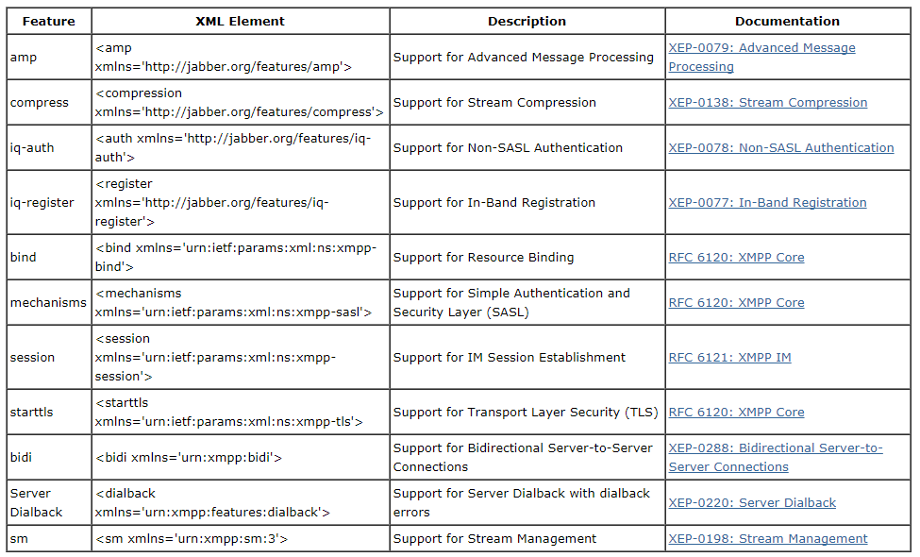
XML Stream Features

Slide 11
Security Stuff
Start-TLS
Prove the identity of the server
Prove the identity of the user (optional)
Encryption
Data integrity
SASL(Simple Authentication and Security Layer protocol) (RFC 4422)
Authentication
Optional encryption (rarely used)
Pluggable (e.g. passwords, Kerberos, X.509, SAML, etc.)

Slide 12
Stanzas
All have to='JID' and from='JID' addresses
To gives destination
From added by local server
Each stanza routed separately
All contents of stanza passed along
Extend with any XML from your namespace
Different types for delivery semantics
<message/>: one direction, one recipient
<presence/>: one direction, publish to many
<iq/>: "info/query", request/response
See details next page

Slide 13
Message
Example: <message xml:lang='en' to='romeo@example.net' from='juliet@example.com/balcony' type='chat'> <body>Wherefore art thou, Romeo?</body> </message>
Types: chat, groupchat, headline, error
Body: plain text
XHTML IM: XEP-0071
Notes:
The protocol enables an XMPP entity to format a message using a small range of commonly-used HTML elements, attributes, and style properties that are suitable for use in instant messaging.

Slide 14
Presence
express an entity's current network availability
Example: <presence> <show>dnd</show> <status>Meeting</status> <priority>1</priority> </presence>
Show: chat, available, away, xa, dnd
Status: Human-readable text
Priority: Which resource "most available"?

Slide 15
IQ Request
a structured request-response mechanism
Example: <iq type='get' id='roster_1'> <query xmlns='jabber:iq:roster'/> </iq>
Type: get, set, result, error
ID: track the corresponding response
Query/Namespace: what type of request?

Slide 16
IQ Response (Roster)
Example: <iq type='result' id='roster_1'> <query xmlns='jabber:iq:roster'> <item jid='romeo@example.net' name='Romeo' subscription='both'> <group>Friends</group> </item> </query> </iq>
Type: response
ID matches request
Subscription state: none, to, from, both

Slide 17
Subscribing to Presence
Send a subscription request: <presence to='juliet@example.com' type='subscribe'/>
Approving a request: <presence to='romeo@example.net' type='subscribed'/>
Every time you change a subscription, you get a "roster push": <iq type='set'> <query xmlns='jabber:iq:roster'> <item jid='romeo@example.net' subscription='from'/> </query> </iq>

Slide 18
Extensibility Example: Message
Use a new namespace
Key: if you don't understand it, ignore it
Example, CAP, XEP-0127: <message to='weatherbot@jabber.org' from='KSTO@NWS.NOAA.GOV'> <alert xmlns='http://www.incident.com/cap/1.0'> <identifier>KSTO1055887203</identifier> <sent>2003-06-17T14:57:00-07:00</sent> <info> <category>Met</category> <event>SEVERE THUNDERSTORM</event> ... </info> </alert> </message>
Common Alerting Protocol (CAP) Over XMPP

Slide 19
Extensibility Example: Presence
Keep presence stanzas small
Example: Entity Capabilities, XEP-0115: <presence from='bard@shakespeare.lit/globe'> <c xmlns='http://jabber.org/protocol/caps' hash='sha-1' node='http://www.chatopus.com' ver='zHyEOgxTrkpSdGcQKH8EFPLsriY='/> </presence>
Ver attribute is hash of all features of this client
Hash -> Feature list is cached
It defines an XMPP protocol extension for broadcasting and dynamically discovering client, device, or generic entity capabilities.

Slide 20
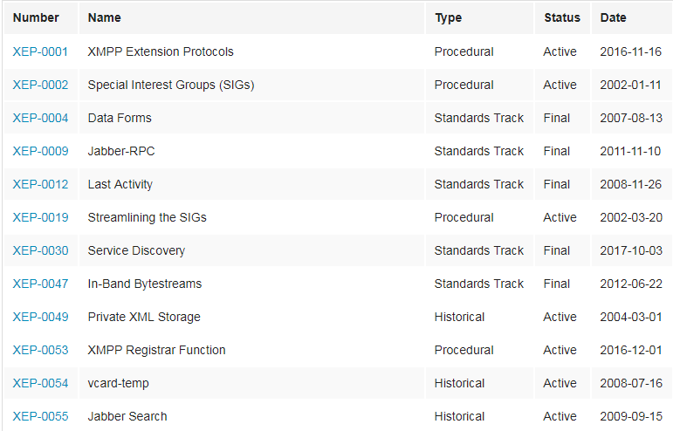
XMPP Extensions
Many already exist: http://www.xmpp.org/extensions/
Add new ones
Custom: use a namespace you control, make up protocol
Standardized: write a XEP.

Slide 21
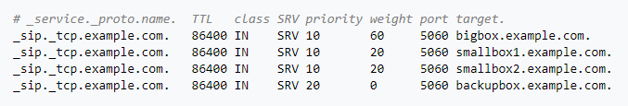
Federation: DNS
Starts with: non-local domain in to address
Look up this DNS SRV record: (service record) _xmpp-server._tcp.domain
Example: jabber.com: 10 0 5269 jabber.com.
Priority: Which one to try first if multiple
Weight: Within a priority, what percentage chance?
Port: TCP port number
Target: Machine to connect to

Slide 22
Federation: Security
Old-style: dialback
Connect back to domain claimed by initiator
Check secret claimed by initiator
"Someone said they were example.com; was that you?"
New-style: Mutual TLS
Initiator presents "client" certificate
Responder presents "server" certificate
Both certificates signed by trusted CA
All stanzas must have from with correct domain

Slide 23
Bandwidth minimization
TLS compression
Not implemented in all SSL/TLS stacks
Some want compression w/o encryption
XEP-0138: Stream Compression
Defines zlib mechanism (2-3x or more compression)
Others can be added
Concern: battery drain vs. radio transmission
XEP-0198: Stanza Acknowledgements
Quick reconnects
Avoid re-synchronizing state on startup
Partial rosters
Privacy lists
Others being pursued

Slide 24
Latency
Most critical on startup
Several handshakes and stream restarts
Can be minimized by client assuming server configuration
Example: don't wait for <stream:features>
Once running
Stanza size matters: try to stay under 8kB, take larger blocks out of band if possible
Configure federation to keep links open, first stanza will be slow
Beware of DoS protection, "karma"
Notes:
KARMA is a set of tools for assessing the security of wireless clients at multiple layers. Wireless sniffing tools discover clients and their preferred/trusted networks by passively listening for 802.11 Probe Request frames. From there, individual clients can be targetted by creating a Rogue AP for one of their probed networks (which they may join automatically) or using a custom driver that responds to probes and association requests for any SSID. Higher-level fake services can then capture credentials or exploit client-side vulnerabilities on the host.
KARMA includes patches for the Linux MADWifi driver to allow the creation of an 802.11 Access Point that responds to any probed SSID. So if a client looks for ‘linksys’, it is ‘linksys’ to them (even while it may be ‘tmobile’ to someone else). Operating in this fashion has revealed vulnerabilities in how Windows XP and MacOS X look for networks, so clients may join even if their preferred networks list is empty.
KARMA stands for Karma Attacks Radio Machines Automatically. A radio machine could simply be a smart-phone, tablet, laptop or any wi-fi enabled device. It is a man-in-the-middle attack that it creates a rough AP and attacker could intercept all the traffic passing from the AP.

Slide 25
Reading List
RFCs
6120: Core
6121: IM & Presence
5122: XMPP URIs
XEP highlights
4: Forms
30: Disco
45: Chat rooms
60: Pub/Sub
71: XHTML
115: Capabilities
163: PEP

Slide 26
Advantages of XMPP
The primary advantage is XMPP's decentralized nature.
XMPP works similar to email, operating across a distributed network of transfer agents rather than relying on a single, central server or broker (as CoAP and MQTT do).
As with email, it’s easy for anyone to run their own XMPP server, allowing device manufacturers and API operators to create and manage their own network of devices.
And because anyone can run their own server, if security is required, that server could be isolated on a company intranet behind secure authentication protocols using built-in TLS encryption.

Slide 27
Disadvantages of XMPP
One of the largest flaws is the lack of end-to-end encryption. While there are many use cases in which encryption may not yet be necessary, most IoT devices will ultimately need it. The lack of end-to-end encryption is a major downside for IoT manufacturers.
https://wiki.xmpp.org/web/XMPP_E2E_Security
Another downside is the lack of Quality of Service (QoS). Making sure that messages are delivered is even more important in the IoT world than it was in the instant messaging world. If your alarm system doesn’t receive the message to turn itself on, then that vacation you’ve been planning could easily be ruined.

Slide 28

Q and A

